Slide 1
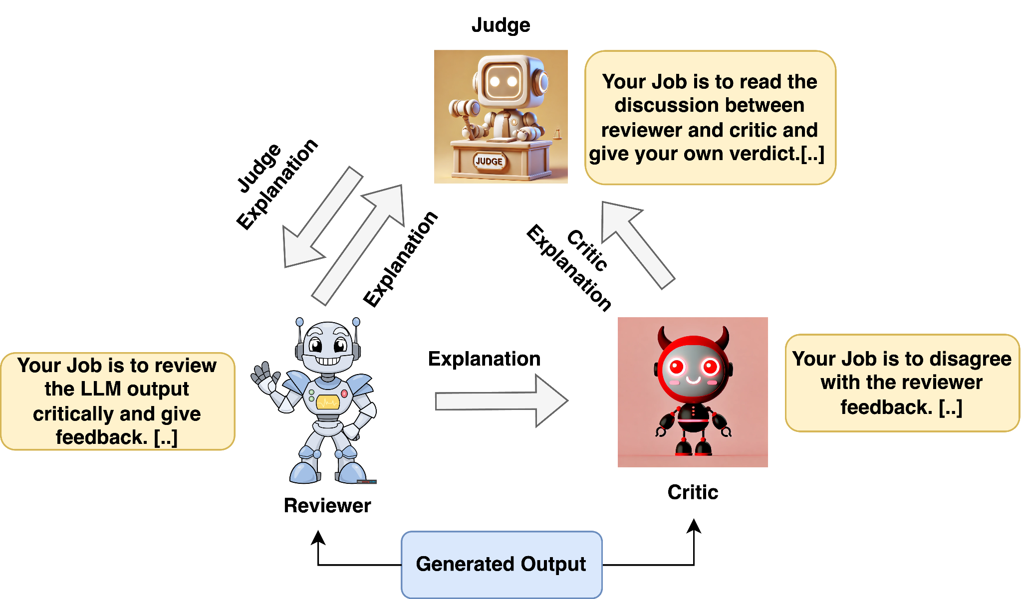
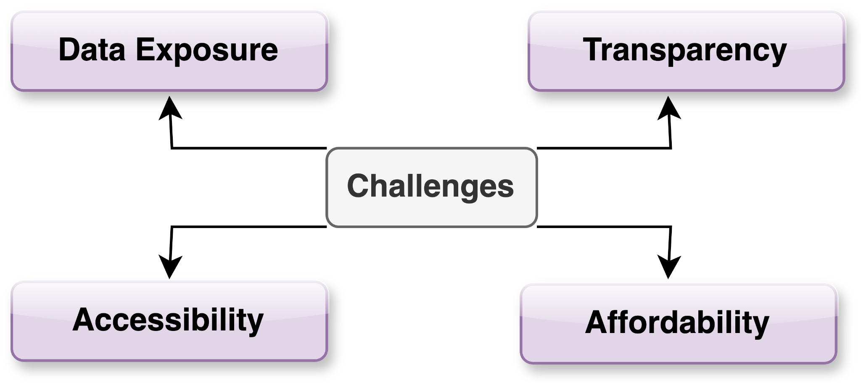
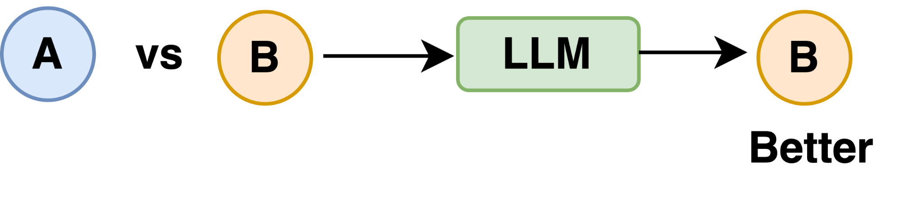
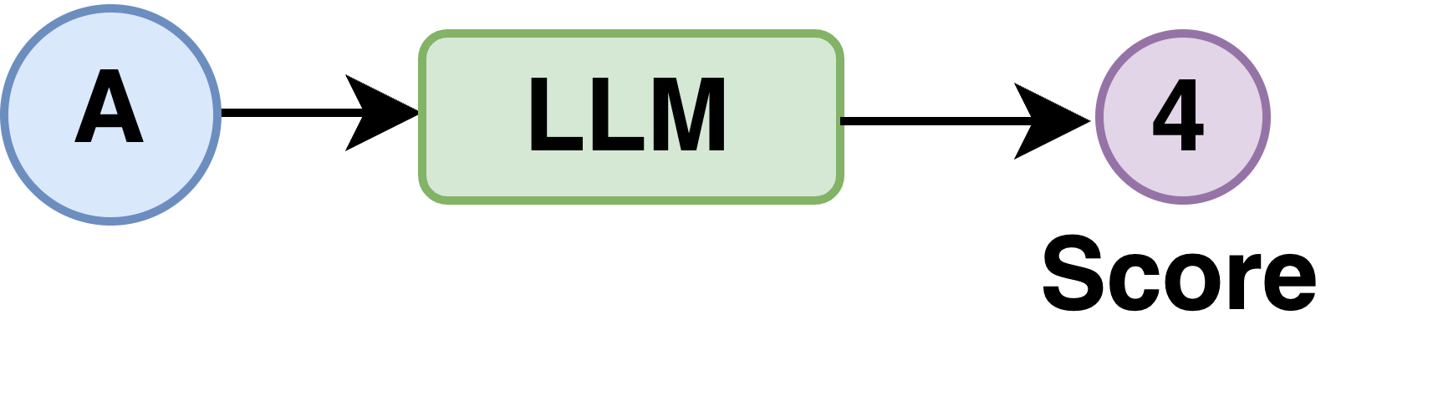
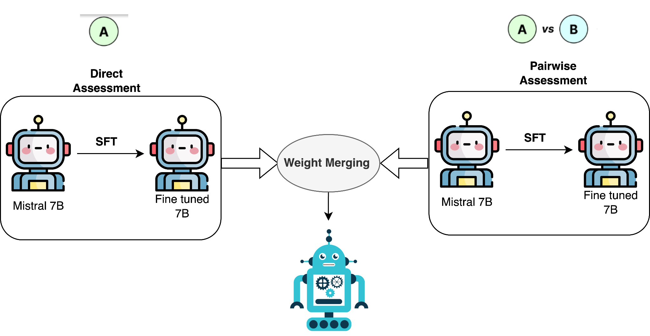
OFLMEval: An Open Source Language Model
with Better Fine-grained Human Alignment
RFEST
2024
Problem Definition and Motivation
Human evaluation is costly, time consuming and is hard to reproduce.
Existing works (GPTEval, GPTScore, etc) use GPT-4 as an evaluators but challenges:-
Aim: To build a strong Open source Language model for fine-grained evaluation of language models
Proposed Methodology-1 (Debate Agent)
Evaluation Types
Pairwise comparison:
Single answer grading:
MultiAgent Result
LLAMA 70B agentic framework beats GPT-4 direct scoring method by approx 1.5 points on Spearman (ρ), Pearson coefficient (r) (-1 to 1 scale) on most of fine-grained metrics..
Drawbacks:
Requires much GPU
Slow inference
To address these limitations, we introduce Method 2.
 | FLU |  | REL |  | CON |  | COH
 | r | ρ | r | ρ | r | ρ | r | ρ
GPT-4 | 0.5924 | 0.5058 | 0.5882 | 0.5636 | 0.5906 | 0.5007 | 0.5851 | 0.5711
Mistral 7b | 0.4067 | 0.3614 | 0.3935 | 0.3647 | 0.4306 | 0.4207 | 0.367 | 0.3665
Llama 70B | 0.5812 | 0.4823 | 0.509 | 0.4736 | 0.6806 | 0.5949 | 0.5777 | 0.5723
MultiAgent | 0.6212 | 0.5189 | 0.5982 | 0.5789 | 0.6987 | 0.6051 | 0.5982 | 0.5789
Dataset
SummEval summarization dataset (CNN/DailyMail).
It includes human ratings for four fine-grained metrics for each summary ie: fluency (FLU), coherence (COH), consistency (CON) and relevance (REL).
Proposed Methodology-2 (Weight Merging)
Results and Discussion (Weight Merging)
In Method 2, we instruction-finetuned Mistral 7B using LoRA on the direct assessment and pairwise datasets separately, then merged their weights.
Final Weight = α*θ_LoRA_pairwise + (1-α)*θ_LoRA_direct
PairwiseResults: Agreement score (0-1)
Direct assessment and pairwise evaluation complement each other, as shown by increase in their scores.
 | COH | FLU | REL | CON
Llama3-8b | 0.5319 | 0.2723 | 0.5545 | 0.2159
Llama3-13b | 0.5613 | 0.3121 | 0.5745 | 0.2541
Mistral 7b | 0.5733 | 0.3341 | 0.5782 | 0.3284
Mistral 7b (IFT) | 0.5913 | 0.3921 | 0.5943 | 0.3891
Mistral 7b (IFT +WM)) | 0.6311 | 0.4213 | 0.61328 | 0.4074
x
Direct Assessment Results (Weight Merging)
 | FLU |  | REL |  | CON |  | COH
 | r | ρ | r | ρ | r | ρ | r | ρ
Mistral 7b | 0.4067 | 0.3614 | 0.3935 | 0.3647 | 0.4306 | 0.4207 | 0.367 | 0.3665
Mistral 7b (IFT) | 0.4239 | 0.3712 | 0.4123 | 0.3711 | 0.4531 | 0.4421 | 0.388 | 0.3711
Mistral 7b (IFT) + WM | 0.4451 | 0.3872 | 0.4311 | 0.3812 | 0.4628 | 0.4512 | 0.376 | 0.3861
Contact information: Sandeep Kumar | Team: Natural Language Intelligence

